Slide 1


NAVIANCE
Preparation for College, Career, and Life

Slide 2
Why Do We Use Naviance?
Grade specific Naviance tasks provide students opportunities for self-discovery, career and college exploration, academic planning, and post-secondary planning.
The tasks within each grade level are designed to scaffold students, as they make more informed decisions before and after high school graduation, no matter what post-high school pathway they choose.

Slide 3
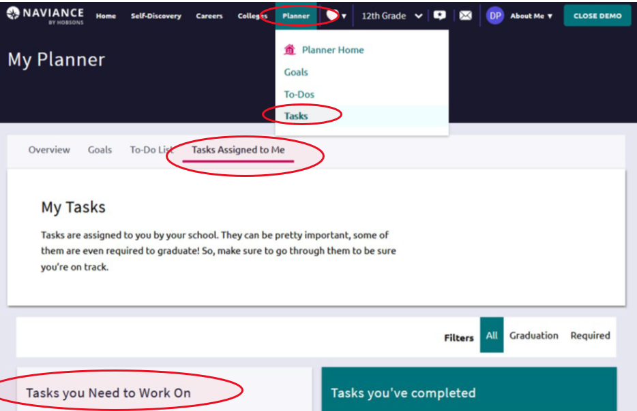
How To Access Naviance- Computer
Log into CLEVER and click on the NAVIANCE icon under Resources.
Click the Planner tab.
Click Tasks.
Click Tasks assigned to me.
Complete your assigned activities under Tasks you Need to Work On.

Slide 4
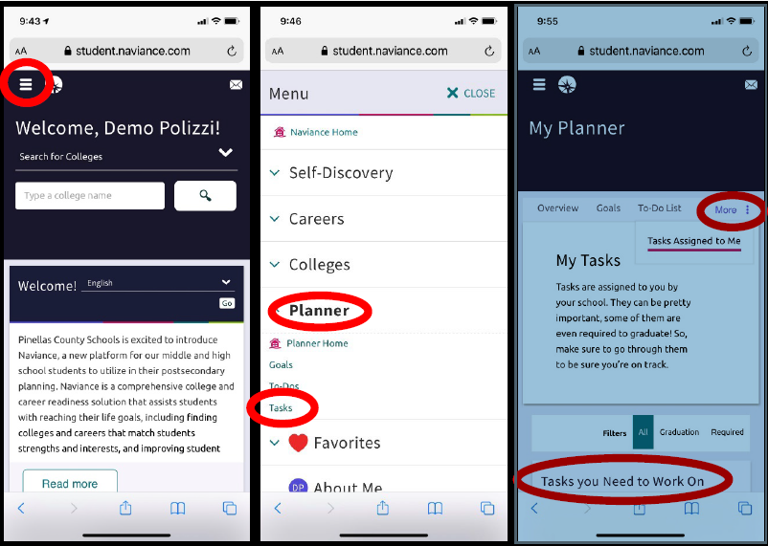
How to Access NAVIANCE - cell phone
1. Log into Clever and then click the Naviance icon under resources.
2. Click the Hamburger menu.
3. Select the Planner menu.
4. Click Tasks.
5. Click Tasks Assigned to Me located under “more”
6. Complete your assigned activities under Tasks you Need to Work On.

Slide 5
9th grade Required Tasks
Semester One
1. Transition to High School Survey
2. Create, Review, or Edit Course Plan
Instructions
Semester Two
AchieveWorks Personality Assessment Instructions
2. Build Resume
Click the About Me tab in the main menu.
Click Resume.
Click the Plus button to start building your resume of activities, experience, skills, awards, etc.
Once finished building your resume, select Print/Export Resume.
  Name the resume
  Select a template
  Check the sections to be added
  Select Save
3. Growing My Resume Reflection Survey

Slide 6
10th Grade Required Tasks
Semester 1
1. Career Interest Profiler
Research the career profiles of your top results.
Favorite (♥) at least 3 careers of interest to complete the next task.
2. Add 3 Careers to My List
Favorite (♥) at least 3 careers of interest if you haven’t already done so.
3. Career Exploration through Roadtrip Nation Interviews
Click the Careers tab in the main menu.
Click Explore Roadtrip Nation Videos.
Click What’s your road?.
Click Define Your Road and complete Steps 1-3.
Watch at least 3 interview videos.
To complete this task, return to Tasks Assigned to Me and leave a comment in the Career Exploration through Roadtrip Nation Interviews comment box.
Semester 2
1. SuperMatch College Search
College SuperMatch Instructions.pdf
Use the Choose Fit Criteria tabs (e.g., Location, Academics, Student Life, Cost, etc.) under the "SuperMatch College Search" banner to select your criteria.
Favorite (♥) at least 6 colleges of interest to complete the next task.
2. Add 6 Colleges to My List
Favorite (♥) at least 6 colleges of interest to complete the next task if you have not already done so.

Slide 7
11th Grade Required Tasks
Semester One
1. My Post-Secondary Payment Plan
Complete the My Post-Secondary Payment Plan 2022.pdf activity sheet.
To complete this task, use your completed payment plan to answer the My Post-Secondary Payment Plan survey questions.
Semester Two
1. Complete Game Plan Survey
Move your final list of colleges from Colleges I'm Thinking About to Colleges I'm Applying To.
Learn how to request a transcript using eDocs by reviewing the Junior Year eDocs Preparation.pdf file.
Complete the Game Plan Survey regardless if college is your plan or not to mark the task complete.
  Click the About Me tab in the main menu.
  Click Game Plan Survey.

Slide 8
12th Grade Required Tasks
Semester One
1. eDocs Orientation
Move your final list of colleges from Colleges I'm Thinking About to Colleges I'm Applying To.
Review the Gr12 S1 eDocs Orientation.pdf.
Watch the Common App Account Matching Video.
  Or view the Common App Account Matching Guide.
Complete the eDocs Orientation survey to mark the task complete.
2. Add 3 Scholarships to My List
Click the Colleges tab in the main menu.
Click Scholarship Search.
Favorite (♥) at least 3 scholarships.
Complete the FAFSA at some point during 1st Semester.
Complete the FFAA at some point during 1st Semester.
Complete the PEFSA at some point during 1st Semester.
Semester Two
1. 2023 Senior Survey
You MUST complete the survey if you need to request final transcripts.

Slide 9
NAVIANCE HOW TO VIDEO'S
Introduction to Naviance: https://www.screencast.com/t/tbcYt9eUkKg
Common App Registration and Account Matching: https://www.screencast.com/t/wJlv73VNdeA
Building a List of Colleges I’m Applying To: https://www.screencast.com/t/jp4DehOsrA
Editing Colleges I’m Applying To: https://www.screencast.com/t/oUbZbG8qSuR
Request Transcripts in Naviance Student: https://www.screencast.com/t/LMtSIif3e1
Requesting a Final Transcript: https://www.screencast.com/t/X4WK0KNZN
Letter of Recommendation Requests: https://www.screencast.com/t/yFlgLhUy

Slide 10



Questions
Mrs. Miller A-G
Ms. Perry H-O
Dr. Hallas P-Z
Ms. Johnson - IB

Slide 11
Questions
Mrs. Miller A-G
Ms. Perry H-O
Dr. Hallas P-Z
Ms. Johnson - IB

